Slide 1
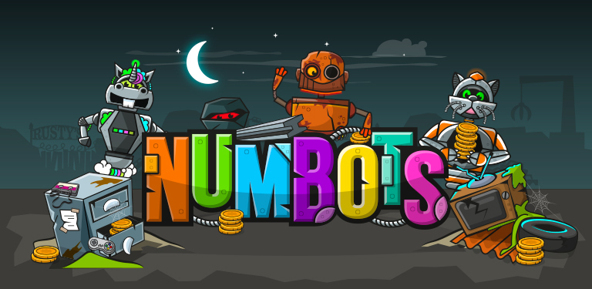
Parent Information Session - Wednesday 21st May 2025

Slide 2
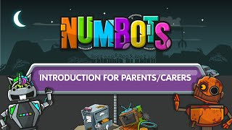
Introduction to Numbots

Slide 3
Why have we introduced Numbots?
Numbots works on basic mathematical skills which are needed to sure progression
To increase fluency. We want children to increase their speed of recognising amounts/representation; improve their + and - speeds and improve their recall of number bonds (These are all key skills in early maths development)
It is an engaging and exciting programme which follows a mastery approach to learning. ‘Master’ before moving on - this fits in with our approach to maths teaching. There are also certificates that can be awarded to children at different stages of progress
Excellent progress tracking tools which can help teachers identify areas for development and intervention
It can be used at school and at home. Children have their own robot and they can earn coins to buy new items for their robot

Slide 4
Key Focus Areas
* Subitising Numbers (instantly recognising a quantity of objects without having to count them individually)
* Number Bonds (pairs of numbers that add up to a specific amount
* Addition and Subtraction

Slide 5
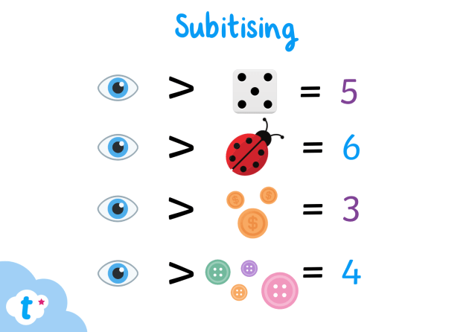

Subitising Numbers: Examples

Slide 6
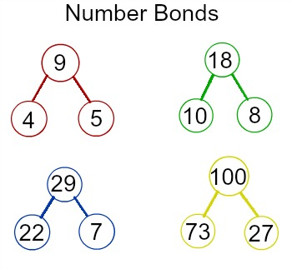

Number Bonds: Examples

Slide 7


Addition and Subtraction

Slide 8
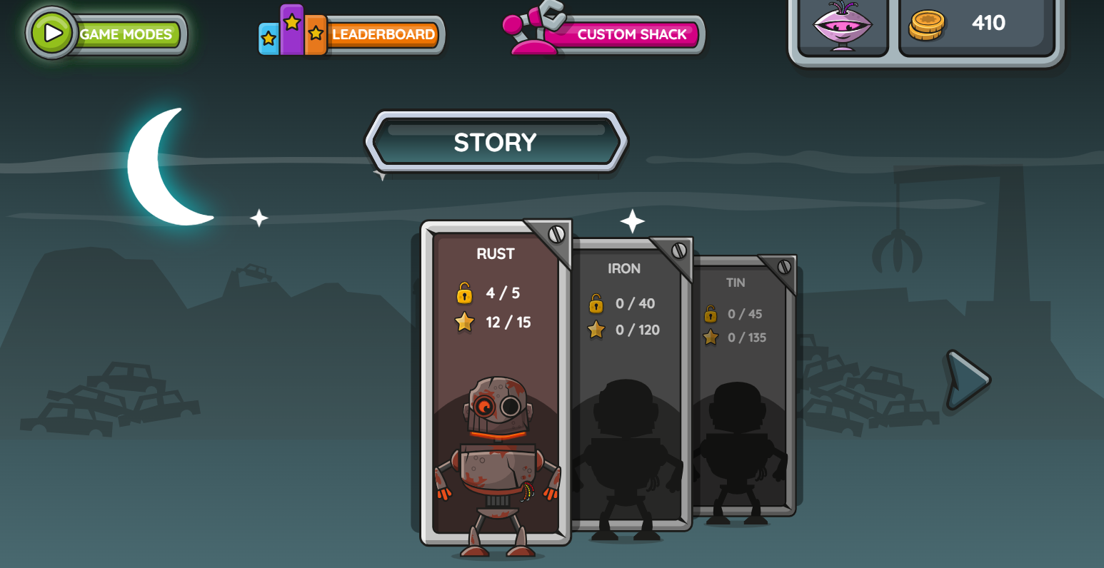
Games Modes - Story Mode
Story Mode consists of 18 stages, each containing numerous levels which players must pass to unlock the next, focusing on conceptual understanding of core maths. Using a variety of visual representations, Story Mode introduces different calculation strategies.

Slide 9
Story Mode
It can take a while and seem quite simple to start with. But the programme uses an algorithm and wants to check what children already know so it can tailor questions for them. As children move up the levels, the difficulty increases. As mentioned previously in the intro video, children are aiming to master these concepts so must achieve at least 2 stars to move on.

Slide 10
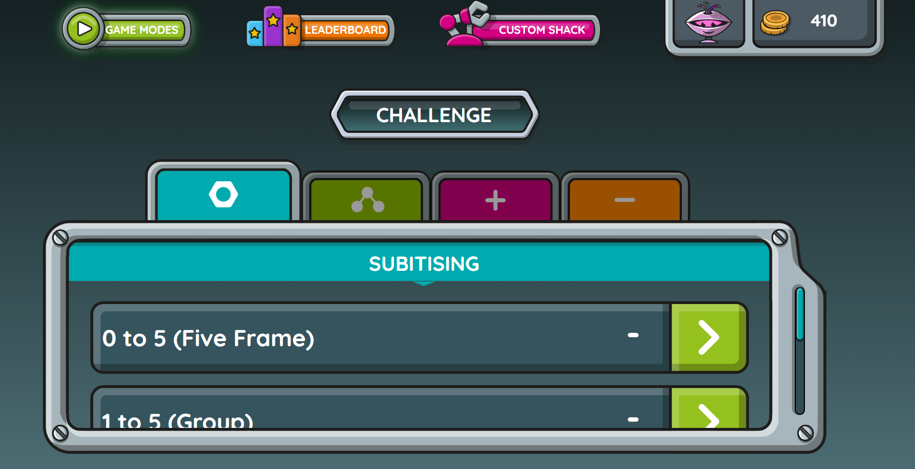
Games Modes - Challenge Mode
Challenge Mode consists of rapid responses to essential maths facts against the clock. Each of the 30 challenges focuses on a key skill or objective, and each game lasts 1 minute. Unlike Story Mode, all of the challenges are available to play as soon as Challenge Mode is unlocked.
However, children must complete so much of the Story Mode before Challenge Mode is unlocked.

Slide 11
What if my child is finding it difficult?
Encourage your child to keep trying, re-do the level and don’t worry if they are slow to start with. They will improve as they keep on using the programme
Children are not expected to pass each level first time - they can also press the ‘i’ icon for further instructions if they are stuck
Perseverance is key as the idea is that children master each concept rather than just moving on through the programme. If they are scoring 0 or 1 star, it is likely that their speed of answering needs to increase to be able to cope with the next level (they are still earning coins on each attempt which they can use towards their robot)
In Challenge Mode, settings can be changed to switch off the timer (if required)

Slide 12
What is the school’s expectation for Numbots use?
We will use this in school wherever possible to help support our pupils in maths based activities
It would be fantastic if children could be logging on at home as well to really work through and secure these concepts (they will really help them with their maths journey!)
We recommend a ‘Little but often’ approach. Numbots suggests children use the programme 4 to 5 times per week for 3 minutes. However, we appreciate that it is not always possible to logon every day so as often as possible would be brilliant (2-3 times per week would be great)
Those children that do logon regularly do show great improvements in their recall of these basic skills

